Slide 1
Investigating Motor Skill Training and User Arousal Levels in VR : Pilot Study and Observations
IEEE VR 2021

Slide 2
Introduction
1. Virtual Reality (VR) for skill training is seeing increasing interest from academia and industry thanks to the highly immersive and realistic training opportunities they offer.
2. There is a need for a closer examination of the link between the user’s arousal levels and training performance.
3. Objective bio-signal data also allows for a more fine-grained look at variations in arousal across tasks with varying difficulty levels.

Slide 3
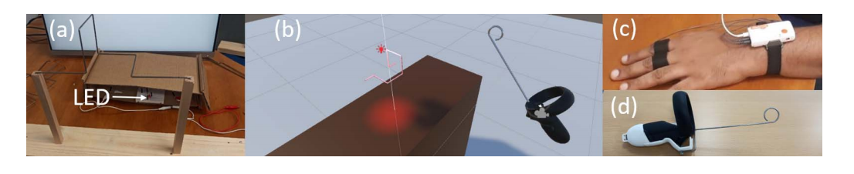
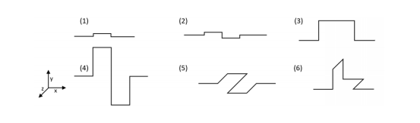
Method
1. Buzzwire game, Unity3D, Oculus controller, GSR and Polar H10, 12 participants.

Slide 4
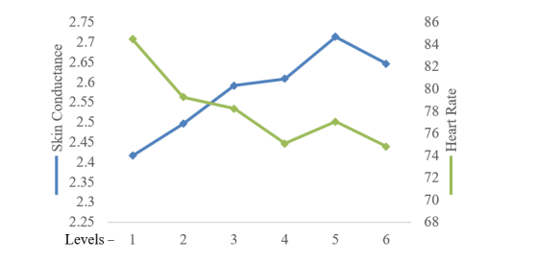
Results
1. HR and skin conductance.

Slide 5
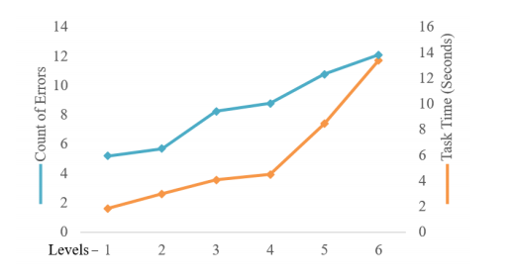
Results
2. Count of Errors.

Slide 6
Conclusion
1. The SC levels scaled up with the difficulty levels while the HR levels showed the opposite trend.
2. Further investigation with a larger sample of participants needs to be done to conclude the relation between arousal levels as measured by the bio-sensors and training performance.

Slide 7
下周计划
修改毕业论文。

